Slide 1
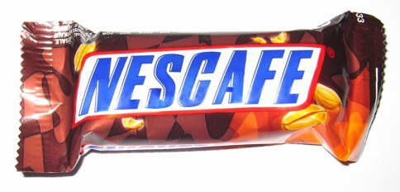
The standard character mark: really?

